Slide 1
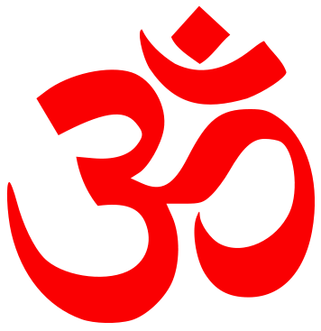
Hinduism

Slide 2
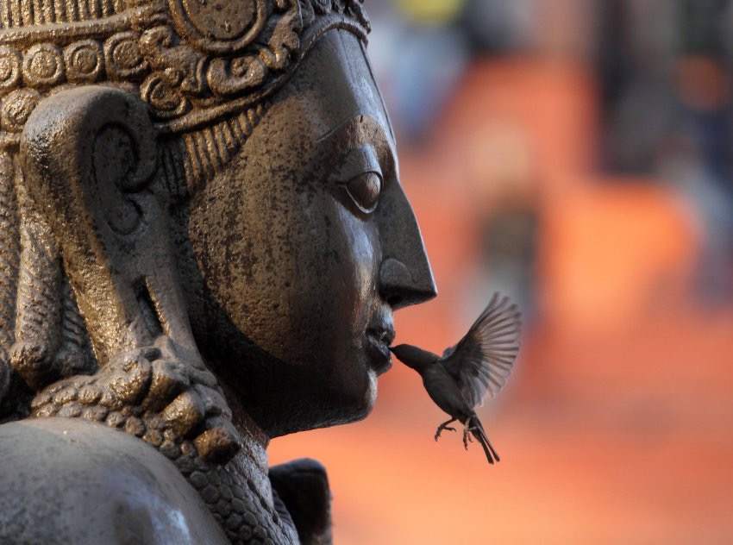

Slide 3
The Hindu sacred writings, the vedas and the upanisads, are the very oldest written religious texts in the world.
They do not express a single idea or a single philosophical system, but rather they express a cluster of related ideas and systems with a family resemblance to each other. Thus while certain themes are consistent, they are often presented with great variations of emphasis.
Even a single text might be the product of several authors, not just one.

Slide 4
Major Themes in Hinduism
Polytheism - many gods
Brahmin - the ultimate unity of the world and the metaphysical ground of all things.
Atman - the higher self
Samsara - the suffering that arises from attachment
Moksha - liberation from suffering.
Dharma - the law, the moral way of living.
Karma - the way in which one’s actions produce consequences for who you are, and for what your ‘destiny’ will be.

Slide 5
The Hymn of Creation” (Rig Veda, 10.129.1-7)
1. Non-being then existed, nor being.
There was no air, nor sky that is beyond it.
What was concealed? Wherein? In whose protection?
And was there deep unfathomable water?
2. Death then existed, not, nor life eternal.
Of neither night nor day was any token.
By its inherent force the One breathed windless,
No other thing than that beyond existed.
3. Darkness there was at first, by darkness hidden;
Without distinctive marks, this all was water.
That which, becoming, by the void was covered,
That One by force of heat came into being.

Slide 6
4. Desire entered the One in the beginning;
It was the earliest seed, of thought the product.
The sages searching in their hearts with wisdom,
Found out the bond of being in non-being.
5. Their ray extended light across the darkness:
But was the One above or was it under?
Creative force was there, and fertile power:
Below was energy, above was impulse.
6. Who knows for certain. Who shall here declare it?
Whence was it born, and whence came this creation?
The gods were born after this world’s creation:
Then who can know from whence it has arisen?
7. None know whence creation has arisen;
And whether he has or has not produced it.
He who surveys it in the highest heaven,
He only knows, or haply he may know not.

Slide 7
It moves. It moves not.
It is far, it is near.
It is within all this.
And It is outside of all this.
Now, he who is on all beings
Looks as just in the Self (Atman)
And on the Self as in all beings --
He does not shrink away from Him.
In whom all beings
Have become just the Self of the discerner --
Then what delusion, what sorrow is there,
Of him who perceives the unity!
Isa Upansiad, 5-7

Slide 8
Those abiding in the midst of ignorance
Self-wise, thinking themselves learned,
Running hither and thither, go around deluded
Like blind men led by one who is himself blind.
(Katha Upanisad, 2:5)

Slide 9
The wise one (the Atman) is not born, nor dies.
This one has not come from anywhere, has not become anyone.
Unborn, constant, eternal, primeval, this one
Is not slain when the body is slain.
If the slayer think to slay,
If the slain think himself slain,
Both these understand not.
This one slays not, nor is slain.
More minute than the minute, greater than the great,
Is the Self that is set in the heart of a creature here.
One who is without the active will beholds Him, and becomes freed from sorrow --
When through the grace of the Creator he beholds the greatness of the Self.
(Katha Upanisad, 2:18-19)

Slide 10
Know the Self (Atman) as riding in a chariot,
The body as the chariot.
Know thou the intellect as the chariot-driver,
And the mind as the reins.
The senses, they say, are the horses;
The objects of sense, what they range over.
The self combined with senses and mind
Wise men call “the enjoyer”.
(Katha Upanisad, 3:3-4)

Slide 11
He, however, who has not understanding,
Who is unmindful and ever impure,
Reaches not the goal,
But goes on to transmigration [ie. reincarnation]
He, however, who has understanding,
Who is mindful and ever pure,
Reaches the goal
From which he is born no more…
(Katha Upanisad, 3:7-8)

Slide 12
Arise ye! Awake ye!
Obtain your boons and understand them!
A sharpened edge of a razor, hard to traverse,
A difficult path is this -- poets declare!
(Katha Upanisad, 3:14)

Slide 13
Whatever is here, that is there.
Whatever is there, that again is here.
He obtains death after death
Who seems to see a difference here.
By the mind, indeed, is this [realization] to be attained:
There is no difference here at all!
He goes from death to death
Who seems to see a difference here.
(Katha Upanisad, 4:10-11)

Slide 14
According as one acts, according as one conducts himself, so does he become. The doer of good becomes good. The doer of evil becomes evil. One becomes virtuous by virtuous by virtuous action, bad by bad action.
But people say, “A person is made of desires only.”
[In reply:] As is his desire, such is his resolve; as is his resolve, such the action he performs; what action he performs, that he procures for himself.
Where one’s mind is attached— the inner self goes thereto with action, being attached to it alone. Obtaining the end of his action, whatever he does in this world, he comes again from that world to this world of action.
(Bradharanyaka Upanishad)

Slide 15
One should not be negligent of duties to the gods and to the fathers.
Be one to whom a mother is as a god.
Be one to whom a father is as a god.
Be one to whom a teacher is as a god.
Be one to whom a guest is as a god.
(Taittriya Upanisad, 1.11.2)

Slide 16
These rivers, my dear, flow, the eastern toward the east, the western toward the west. They go just from the ocean to the ocean. They become the ocean itself. As there, they know not ‘I am this one’, ‘I am that one’.
Even so, indeed, my dear, all creatures here, though they have come forth from Being, know not ‘We have come forth from Being’. Whatever they are in this world, whether tiger, or lion, or wolf, or boar, or worm, or fly, or gnat, or mosquito, that they become.
That which is the finest essence -- this whole world has that as its self. That is Reality. That is Atman. That Art Thou!
(Chandogya Upanisad, 6:10.1-3)

Slide 17
“Bring hither a fig from there.”
“Here it is, sir.”
“Divide it.”
“It is divided, sir.”
“What do you see there?”
“These rather fine seeds, sir.”
“Of these, please, divide one.”
“It is divided, sir.”
“What do you see there?”
“Nothing at all, sir.”
(continued)

Slide 18
“Verily, my dear, that finest essence which you do not perceive - verily, my dear, from that finest essence this great Nyagrodha (sacred fig tree) thus arises.
“Believe me, my dear,”, said he, “that which is the finest essence - this whole world has that as its self. That is Reality. That is Atman. That Art Thou!”
(Chandogya Upanisad, 6:12:1-3)

Slide 19
In the beginning this world was Self (Atman) alone in the form of a Person. Looking around, he saw nothing else than himself. He said first: “I am”. Thence arose the name “I”…
He was afraid. Therefore one who is alone is afraid. This one then thought to himself, “Since there is nothing else than myself, of what am I afraid?” Thereupon his fear departed…
Verily he had no delight. Therefore one alone has no delight. He desired a second. He was, indeed, as large as a woman and a man closely embraced. He caused that self to fall into two pieces. Therefrom arose a husband and a wife…
He copulated with her. Therefrom human beings were produced.
(continued)

Slide 20
[She changed herself into the forms of various animals; he did likewise]. Thus, indeed, he created all…
He knew, “I, indeed, am this creation, for I emitted it all from myself.” Thence arose creation. Verily, he who has this knowledge comes to be in that creation of his.
Verily, at that time the world was undifferentiated. It became differentiated just by name and form, as the saying is “He has such a name, such a form…”
(Bhradaranyaka Upanisad, 1:4:1-7)

Slide 21
Then Vigaghdha Sakalya questioned him. “How many gods are there, Yajnavalkya?”
He answered in accord with the following nivid (invocation-formula): “As many as are mentioned in the Nivid of the “Hymn to All the Gods’, namely three hundred and three, and three thousand and three. [=3306]
“Yes”, said he, “But just how many gods are there?”
“Thirty-three”
“Yes”, said he, “But just how many gods are there?”
“Six”
“Yes”, said he, “But just how many gods are there?”
“Three”
(continued)

Slide 22
“Yes”, said he, “But just how many gods are there?”
“Two”
“Yes”, said he, “But just how many gods are there?”
“One and a half.”
“Yes”, said he, “But just how many gods are there?”
“One”
“Which is the one god?”
“Breath”, said he. “They call him Brahman.”
(Bhradaranyaka Upanisad, 3:9.1-9)

Slide 23
He who has found and who has awakened to the Self (Atman)
That has entered into this conglomerate abode --
He is the maker of everything, he is the world itself.
The world is his: indeed he is the world itself.
By the mind alone is It [Brahman] to be perceived.
There is on earth no diversity.
He gets death after death
Who perceives here seeming diversity.
(Bhradaranyaka Upanisad, 4:4:13,19)

Slide 24
Now, one should know that Nature (prakriti) is illusion (maya).
And that the Mighty Lord is the illusion-maker.
This whole world is pervaded
With beings that are parts of Him.
Not above, not across,
Nor in the middle has one grasped Him.
There is no likeness of Him
Whose name is Great Glory.
His form is not to be beheld.
No one ever sees Him with the eye.
They who thus know Him with heart and mind
As abiding in the heart become immortal.
Svetasvatara Upanisad
4:10,19-20

Slide 25
When they divided the Purusa, into how many parts did they arrange him? What was his mouth? What his two arms? What are his thighs and feet called?
The brahmin was his mouth, his two arms were made the radian (warrior), his two thighs the vaisya (trader and agriculturalist), from his feet the sudra (servile class) was born.
Rig Veda X:90:11-12

Slide 26
The Blessed Lord said:
Not by abstention from work does a man attain freedom from action; nor by mere renunciation does he attain to his perfection.
For no one can remain even for a moment without doing work; everyone is made to act helplessly by the impulses born of nature.
He who restrains his organs of action but continues in his mind to brood over the objects of sense, whose nature is deluded, is said to be a hypocrite.
But he who controls the senses by the mind, O Arjuna, and without attachment engages the organs of action in the path of work, he is superior.
(Bhagavad Gita, 3:4-7)

Slide 27
Do thou thine allotted work, for action is better than inaction; even the maintenance of thy physical life cannot be effected without action.
Save work done as, and for, a sacrifice. This world is in bondage to work. Therefore, O son of Kunti, do thy work as a sacrifice, becoming free from all attachment.
It was even by works that Janaka and others attained to perfection. Thou should do works also with a view to the maintenance of the world.
As the unlearned act from attachment to their work, so should the learned also act, O Bharata, but without any attachment, with a desire to maintain the world-order.
(Bhagavad Gita, 3:8-9, 20, 25)

Slide 28
Even the man of knowledge acts in accordance with his own nature. Beings follow their nature. What can repression accomplish?
Better is one’s own law though imperfectly carried out than the law of another carried out perfectly. Better is death in the fulfillment of one’s own law, for to follow another’s law is perilous.
(Bhagavad Gita 3: 33, 35)

Slide 29
One has to understand what action is, and likewise one has to understand what is wrong action, and one has to understand about inaction. Hard to understand is the way of work.
He who in action sees inaction, and action in inaction - he is wise among men, he is a yogin, and he has accomplished all his work.
He whose undertakings are free from the will of desire, whose works are burned up in the fire of wisdom - him the wise call a man of learning.
Having abandoned attachment to the fruits of works, ever content,without any kind of dependence, he does nothing though he is ever engaged in work.
(Bhagavad Gita 4:17-20)

Slide 30
He whose self is harmonized by yoga sees the Self abiding in all beings and all beings in the Self; everywhere he sees the same.
He who sees Me everywhere and sees all in Me - I am not lost to him, nor is he lost to Me.
The yogin who, established in oneness, worships Me abiding in all beings lives in Me, howsoever he may be active.
He, O Arjuna, who sees with equality everything, in the image of his own self, whether in pleasure or in pain - he is considered a perfect yogi.
(Bhagavad Gita 6:29-32)

